Slide 1
Interactive Audiobook
Danielle Case WRIT5400 11/27/21

Slide 2
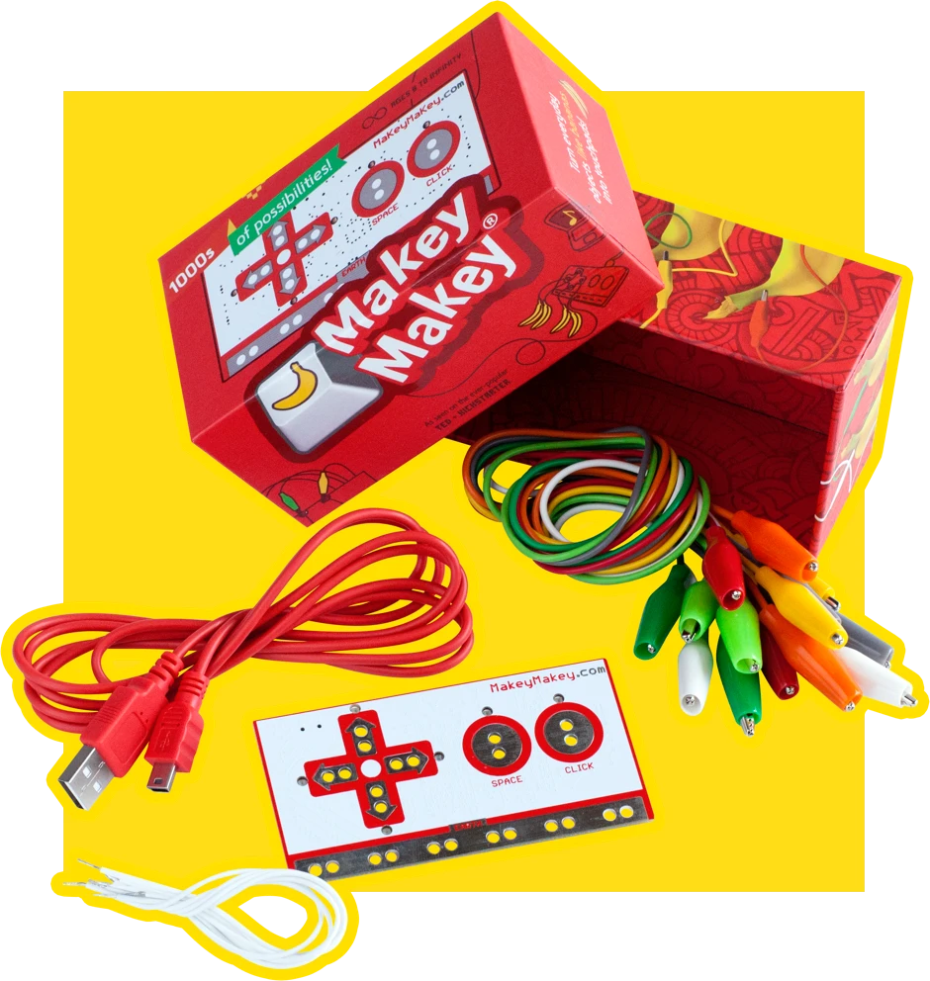
What is makey makey?
MaKey MaKey allows you to transform everyday objects into computer interfaces.
It's a little USB device you plug into your computer, and you use it to make your own switches that act like keys on the keyboard.

Slide 3
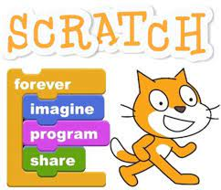
What is scratch?
Scratch is a visual programming language that allows students to create their own interactive stories, games and animations

Slide 4
setting it up
Step 1
Step 2
To make Makey Makey work with Scratch, plug in the USB to a computer and create a Scratch program normally. …
Then, connect one of the alligator clips to Earth at the bottom of the Makey Makey board and touch the metal at the other end of the alligator clip with a finger.

Slide 5
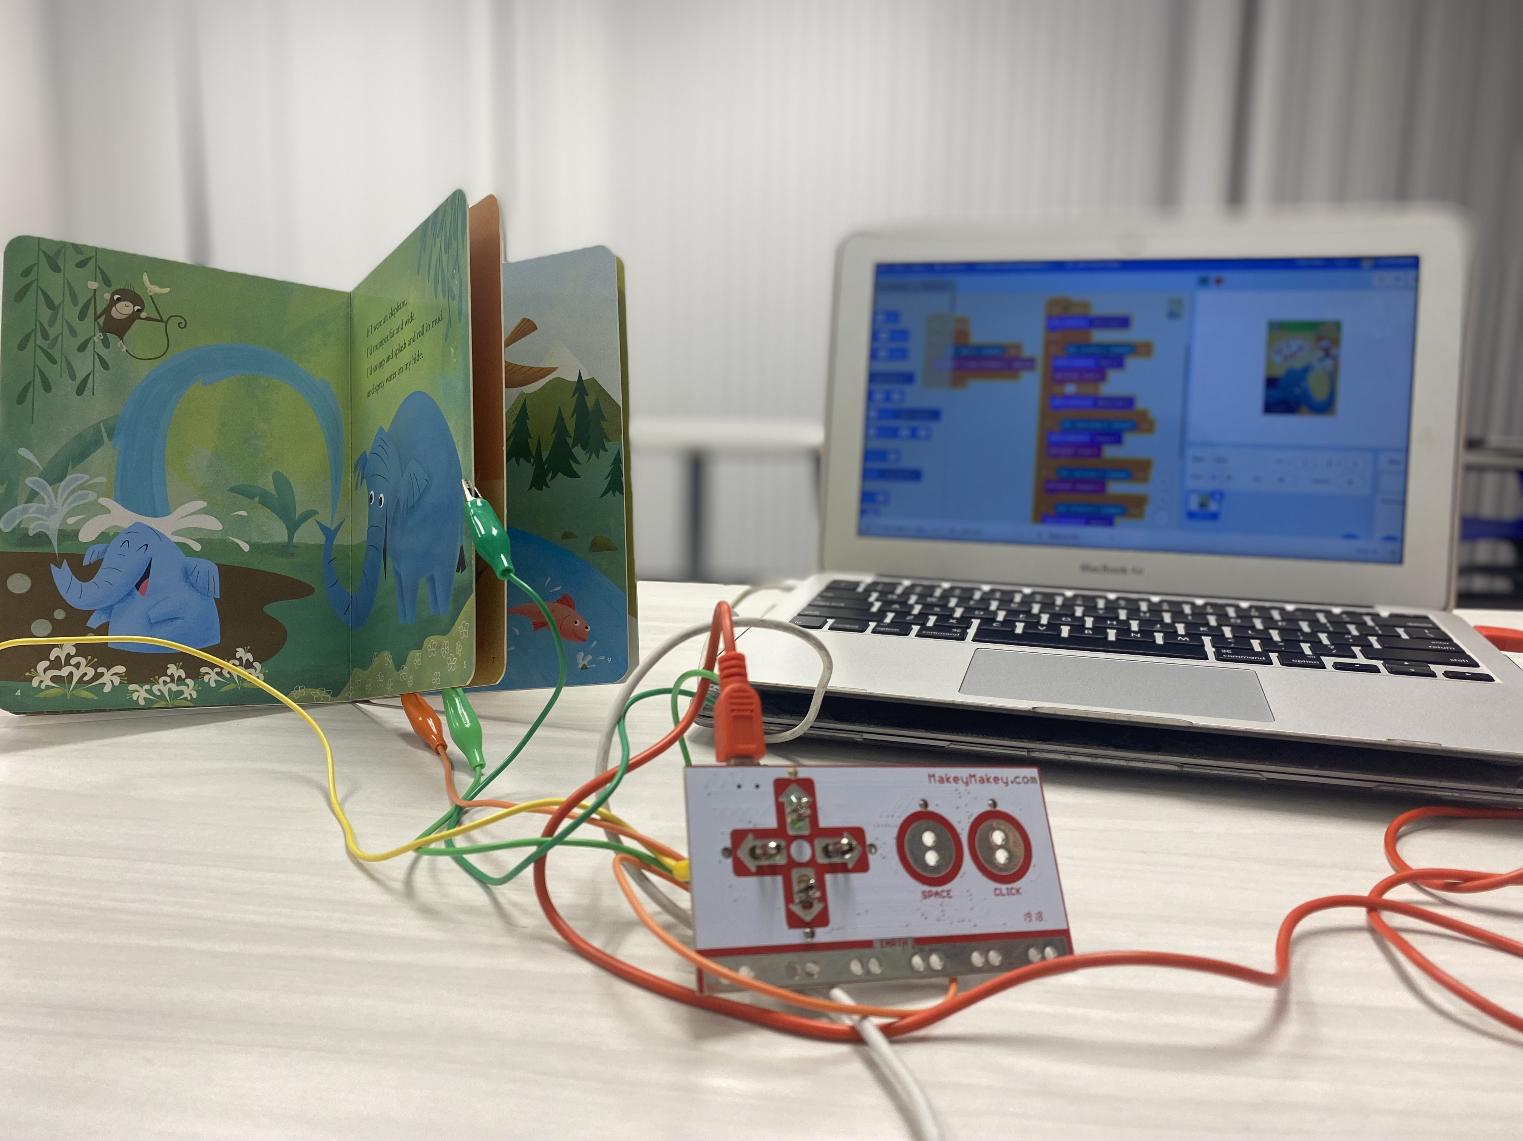
My interactive audiobook
Connect one of the alligator clips to Earth at the bottom of the board and touch the metal at the other end of the alligator clip with a finger.
To make Makey Makey work with Scratch, plug in the USB to a computer and create a Scratch program
Circuit board that turns objects into buttons on the computer .
This ground wire works as a return path for the electricity.

Slide 6
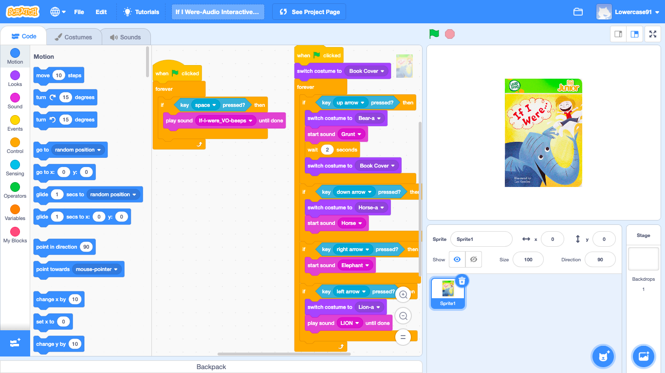
Coding my audiobook
My voice track of the book plays on a loop once the command of the space bar is given.
Costumes change and is on a loop as each animal sound is played.
Audio of the different animals from the book play when the command of the up, down, left or right arrow is given.

Slide 7
The importance of it all
My eversion project of the interactive audiobook is important to because it creates an academic discipline that informs all fields of teaching students how to communicate their ideas but most importantly it engages writing, thinking and argument.

