Slide 1
Assessing Multimodal Selves
Are Our Multi-Modal Writers Learning To Picture-Write Well?
Athena Edwards & Bilal Amodu
WRIT 5340 - Winter 2021

Slide 2
Analyzed Texts:
Theorizing Digital Media Chapter 10: The New Data - Lanius and Hubbell
Theorizing Digital Media: Chapter 16: Pinning, Gazing, and Swiping Together - Jones
The New Work of Assessment: Evaluating Multimodal Learning - Murray et al.
Between Modes: Assessing Student New Media Composition - Madeleine Sorapure

Slide 3
Theorizing Digital Rhetoric
Chapter 10: The New Data - Lanius and Hubbell
Key Terms:
Rhetoric:
The capability to convey deeds, causes, testimony, truths, and opinions
Quantification:
A rhetorical strategy that allows scientists to transfer knowledge
Enthymematic:
Containing a premise and a conclusion; proof is found in the surroundings
Key Points:
If data are arguments, data collection is inherently rhetorical
Current rhetorical theory tends to focus on product, rather than audiences, intentions, & context
Digital Media:
Kairos (time) focused, as it is based on assumptions around the normal
Is a genre composed of both text/content and medium
Quality and validity is determined by repetition and participation
Data Collection Types:
Active
Automated
Notes:
Automated data collections do not always match user conclusions; Automated: continuously being collected, repurposed, reused

Slide 4
Theorizing Digital Rhetoric
Chapter 16: Pinning, Gazing, and Swiping Together - Jones
Key Terms:
Parody:
A form of commentary based in essence and recognition
Identify:
Action requiring symbolism naming, synecdoche/representative usage
Identification:
Action requiring agents that share an essence
Epistemic:
Of or relating to knowledge
Conveyance:
Of transportative nature
Form:
An arousement/anticipation of parts as fulfillment of desires
Key Points:
Identification in visually driven social media age is done via shared forms and rhetorics (as opposed to broadcast similarity and symbolism)
Essential qualities of digital artifacts:
Procedurability
Participation
Spatiality
Encyclopedic scope
Qualities of Digital Media
Hyperlinks and embedded media ask audiences to follow another’s thought processes
Involves symbol manipulation, construction, & interpretation
Pleasure in new media doesn’t stem from not/knowing result, but rather from the participation and community
Notes:
Notable media: Pinterest based on shared practice rather than content; Barbie parody based on form rather than substance; Tinder based on form and procedure (with similarities to chess matches and gaming)
Practice and process based media a product of post-industrialist (services valued over manufacturing), networked spaces.

Slide 5
Discussion Questions
Activity
Digital media, especially with automated data collection, is easily the most efficient method of audience engagement. But what things might get pushed to the side as a result? Alternatively, what does digital media do well?
Looking at some of your most used digital spaces, how might the 4 essential qualities (Procedurability, Participation, Spatiality, and Encyclopedic Scope) show up in their usage?
In what ways do our multimodal selves reflect, or not reflect, our actual identities?
Go to your most used social media app/site.
Tell us about the first thing on your newsfeed.
Have you seen that kind of content before?
Why might it be on your feed?
Do you know what to expect with this content?
How would you engage with this object (like, share, comment, block, etc.)?
Does this item fit with your identity(s)?

Slide 6
How to Create Criteria for Multimodal Works?
How would you interpret this image?

Slide 7
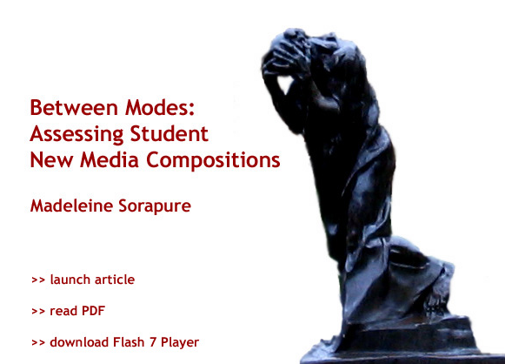
Between Modes:Assessing Student New Media Composition

Slide 8
The problem of assessment
Is Our Children Learning: Evaluates field’s growing preoccupation with assessing multimodal student work
Reflection Pairing: Comments on practice of pairing projects with written reflections
Composition Autarchy: Expresses hesitance to rely exclusively on other disciplines for guidance
Too Many Ways to Skin- The diverse array of modalities and tools to employ has created challenges in creating and maintaining consistent standards
Notes:
What are the goals
Discussions are central to the establishment of new media as a legitimate form of composing
I think that underlying this interest in assessment is the recognition of its importance in connecting new media assignments to broader curricular goals. As with print assignments, when we grade students’ work we are assessing their success in achieving goals that we value and that, ideally, are made explicit to our students. How we evaluate and grade student work is—or should be—connected to everything else in the course, from the assignments themselves to the readings, the class activities, and the software we use. Discussions of new media assessment should therefore help us articulate why new media matters and should help us in establishing, for ourselves and for our students, the key continuities and differences between composing in print and composing in new media.
Believes that composition studies as a self contained discipline should develop its own criteria

Slide 9
Looking between modes
Union Between Modes: Many theorists believe that multiple modes create a unified message
Relationship Focus: Sorapure maintains that instructors should assess modalities in projects based on how they interact.
Too Many Modes: Asserts that emphasis on relationships will diminish tendencies to overrepresent content over multiple modes
Is Your Style Relevant: Encourage students to consider the purpose of the modes they include (beyond simply looking cool(
Notes:
m Kress and van Leeuwen, Selfe, and Ball make clear, composing in new media usually involves bringing together multiple modes—text, image, sound, animation, and/or video—in order to convey a meaning or create an effect. The question for assessment is how this bringing together or composing of modes can be described and then evaluated.

Slide 10
Vocabulary for Unity
Metaphor: A relationship based on substitution (an image standing in for something else)
Metonymy: Modes are united by association
Note on terms: Roman Jakobson claims that while these two are used in verbal language, they are also applicable to image and film
Notes:
Metaphor: ; in a multimodal work, one mode can metaphorically represent or stand in for another, as when an animation of a word dynamically represents its meaning. It is a relation based on similarity between elements in different modes.

Slide 11
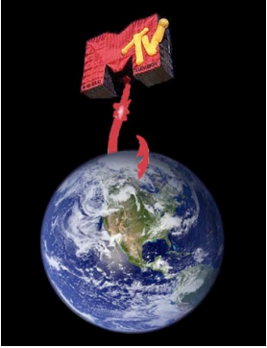
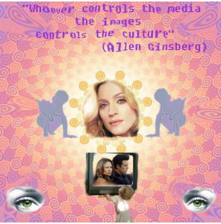
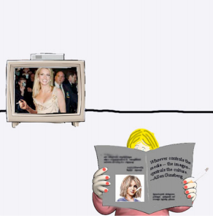
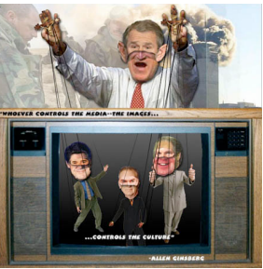
Sorapure’s Assignment
Whoever controls the media—the images—controls the culture.” Allen Ginsberg
Students were asked to use photoshop to create collages to interpret the quote above.

Slide 12
Questions
What are your experience with metaphor and metonymy in either language arts or visual rhetoric? What are some other rhetorical strategies or tropes that can help us evaluate multimodal works?
To what extent does multimodal composition require specialized knowledge from beyond the field of composition? How may deficiencies of said knowledged be addressed and supplemented, if not in a composition classroom?
How can assessment techniques account for inequities in student familiarity with different digital tools?

Slide 13
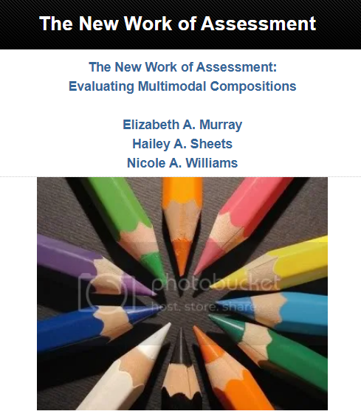
The New Work of Assessment: Evaluating Multimodal Learning
Notes:
This study was conducted by three PhD students at Ball State University
The students aim to apply their department’s program issues first year composition rubric to multimodal projects.

Slide 14
Introduction
The screen now dominates how we communicate
Kress (2005)
Literacy and technology are intertwined
Digital media represents a new form of rhetorical expression
How can this be assessed?
Fortune- No mode on its own
Lemke- Are the modes working together
Sorapure- Context is everything, do not keep it broad
Selfe and Takyoshi- Rhetorical principles guide everything
The students/university take Selfe and Takyoshi’s view
Assert the need for a consistent approach towards assessment
Consistency can be attained by applying/adjusting rubrics used for writing.
Notes:
These rhetorical principles of communication--which composition teachers have applied primarily to literate communication--also apply, just as appropriately to multimodal compositions.
Fortune- Each individual mode cannot be assessed separately
Lemke- If all literature consists of more than one mode, than multimodal compositions can be assessed for interaction between modes
“text and picture together are not two ways of saying the same thing; the text means more when juxtaposed with the picture
Sorapure- "it is a mistake to assess multimodal compositions using a broad rhetorical approach."

Slide 15
Survey/ Results
Researchers surveyed writing instructors
One study focused on those at Bell State
Another focused on Writing Instructors in general
Significant findings
37 percent assign at least one multimodal project, while 35 percent assign two or more
Only 10 percent of WPA are required by writing program to include multimodal assessment
54 percent felt comfortable assigning multimodal projects while 46 percent felt either uneasy or uncomfortable
16 percent felt uncomfortable due to assessment concerns
37 percent of instructors assign non-Powerpoint Multimodal assignments
15 percent claim assessment concerns prevent them from assigning projects more frequently
53 percent did not feel adequately trained by their Writing Program to assess multimodal projects
24 percent felt adequately prepared
16 percent offer full credit if requirements are met
9 percent rely on an affiliated paper to assess a project
Notes:
We also posted the survey on the Writing Program Administrators (WPA) Listserv to receive feedback from a broader field of composition instructors.
10 percent- May suggest why no consistent approach exist
Within Ball State's Writing Program, composition instructors are not using the required program rubric to assess their multimodal projects due to confusion about how a writing rubric used to grade traditional alphabetic essays could be applied to multimodal projects that incorporate both images and texts.
Instead, instructors appear to prefer incorporating into their assignment sequence multimodal projects that are print-based, such as brochures, advertisements, and collages.
less class time has to be devoted to teaching students about the different technologies needed to create some of the more complicated digital texts (websites, video essays, audio essays)
Rubric is easier to apply to printed texts
Within Ball State's Writing Program, composition instructors are not using the required program rubric to assess their multimodal projects due to confusion about how a writing rubric used to grade traditional alphabetic essays could be applied to multimodal projects that incorporate both images and texts.

Slide 16
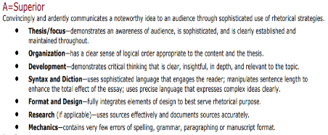
Rubric
The Rubric used at by Bell State’s Writing Program emphasizes seven traits
Thesis/focus
Organization
Development
Syntax and Diction
Format and Design
Research
Mechanics

Slide 17
Application to Multimodality
Thesis/Focus- Not a written sentence, yet an organized overall theme
Organization- How the selected and employed modes interact with each other
Development- How students explore rhetorical possibilities and develop argument by connecting modes.
Syntax and Diction- The selection of text, sound, and images, as well as their overall interaction
Format and Design- Knowledge of and attention to rhetorical principles of design and visual rhetoric
Research- How well sources are documented/employed by composition. Copyright status
Mechanics- Clear, error free text and functioning links
Notes:
The argument—or thesis—will not be presented in a single alphabetic sentence as it is in a traditional essay; instead, the thesis will be evident throughout the essay in the variety of modes that are chosen. Focus will be demonstrated by each mode consistently contributing to the overall argument or thesis of the composition.
Mechanics in a multimodal project might also include making sure links work appropriately and images and text show up as they are supposed to.
the student shows that they are aware of color, typeface, layout, image selections, audio choices, etc. Their decisions about format and design are clearly based upon audience awareness.
Organization
In a multimodal project, a clear sense of logical order is demonstrated through the variety of modes interacting and flowing with one another to support the argument or thesis.
Redundancy: Identical content in each mode; each mode tells the same story.
Complementary: Different content in each mode; both modes are needed to understand the key idea.
Supplementary: Different content in words and pictures; but one mode dominates the other mode.
Juxtaposition: Different content in words and pictures; key ideas are created by a clash or tension between the ideas in each mode.
Stage setting: Different content in words and pictures; one mode forecasts the ideas that come in the other modes.
Syntax/Diction
Just as we would tell students they should choose a stronger, more descriptive, and effective word or phrase in a traditional essay, we would make sure that they have used the strongest, most effective text, images, and/or sounds.
In a multimodal project , format and design are evaluated as to how well the student pays attention to rhetorical principles of design and visual rhetoric; the student shows that they are aware of color, typeface, layout, image selections, audio choices, etc. Their decisions about format and design are clearly based upon audience awareness.

Slide 18
Relationships Between Modes
Redundancy: Each mode tells the same story
Complementary: Each mode has different content, but connects to a key idea
Supplementary: Different content in words or pictures, one mode dominates another
Juxtaposition: Different content in words and pictures; key ideas emerge from a conflict between modes
Stage Setting: Different content in words and pictures; one mode anticipates the ideas expressed in another

Slide 19
Scavenger Hunt: Multimodal Relationships
Instructions:
We will now separate into 1 of 5 breakout rooms. Each room corresponds to a relationship from the previous slide. In your room, you and your partners will have 5 minutes to find a movie poster or meme that illustrates the rhetorical relationship of your room (for example, room 1 would look for Juxtaposition)
After five minutes we will share examples with the class at large
ltimoda
Room Focus
Juxtaposition
2. Stage-Setting
3. Complementary
4. Redundancy
5. Supplementary
Notes:
After reviewing the relationships mentioned above, we can now explore examples to help us identify these techniques in multimodal projects and apply them to our own works

Slide 20
Questions
On a scale of 1-5, how comfortable do you feel assessing multimodal projects after viewing this rubric? (You can hold up a finger if you would like)
As a student, how does having a consistent rubric with clear expectations impact your multimodal composing process? What challenges can students and teachers anticipate from applying writing assessment standards to multimodal works?
In addition to consistent criteria, how else can instructors become more comfortable assigning multimodal products?

